Slide 2
Antra SEP Program
Entity Framework Core

Slide 3
Entity Framework Core
Entity Framework Core is a lightweight, extensible and cross-platform version of Microsoft's object-relational mapper (ORM), Entity Framework is the official data access platform for Microsoft.
Entity Framework is an Object/Relational Mapping (O/RM) framework. It is an enhancement to ADO.NET that gives developers an automated mechanism for accessing & storing the data in the database.
EF Core is intended to be used with .NET Core applications. However, it can also be used with standard .NET 4.5+ framework based applications.

Slide 4
Entity Framework Core
The following figure illustrates the supported application types, .NET Frameworks and OSs.
ASP.NET Core
Applications
Web API,
Console,
etc
.NET 4.5+ Applications
Console,
WinForms,
WPF,
ASP.NET
Devices + IoT,
Mobile,
PC,
Xbox,
Surface Hub
Mobile Application
Android, IOS, Windows
Application Types
EF Core
EF Core
EF Core
EF Core
EF Core
.NET Core
.NET 4.5+
UWP
Xamarine
Framework
Windows, Mac, Linux
Windows
Windows 10
Mobile
OS

Slide 5
EF Core Development Approaches
EF Core supports two development approaches 1) Code-First 2) Database-First.
In the code-first approach, EF Core API creates the database and tables using migration based on the conventions and configuration provided in domain classes. This approach is useful in Domain Driven Design (DDD).
In the database-first approach, EF Core API creates the domain and context classes based on existing database using EF Core commands. This has limited support in EF Core as it does not support visual designer or wizard.

Slide 6
EF Core Development Approaches
Tables
Context and Entity Classes
Entity Framework
Database-First Approach
Generate Data Access Classes for Existing Database
Tables
Domain Classes
Entity Framework
Code-First Approach
Created Database from the Domain Classes

Slide 7
EF Core VS EF 6
Entity Framework Core is the new and improved version of Entity Framework for .NET Core applications.
EF Core continues to support the following features and concepts, same as EF6.
DbContext & DbSet
Data Model
Querying using Linq-to-Entities
Change Tracking
SaveChanges
Migrations

Slide 8
EF Core VS EF 6
EF Core will include most of the features of EF 6 gradually. However, there are some features of EF 6 which are not supported in EF Core 2.0 such as:
EDMX/ Graphical Visualization of Model
Entity Data Model Wizard (for DB-First approach)
ObjectContext API
Querying using Entity SQL.
Automated Migration
Inheritance: Table per type (TPT)
Inheritance: Table per concrete class (TPC)
Many-to-Many without join entity
Entity Splitting
Spatial Data
Lazy loading of related data
Stored procedure mapping with DbContext for CUD operation
Seed data
Automatic migration

Slide 9
EF Core VS EF 6
EF Core includes the following new features which are not supported in EF 6.x:
Easy relationship configuration
Batch INSERT, UPDATE, and DELETE operations
In-memory provider for testing
Support for IoC (Inversion of Control)
Unique constraints
Shadow properties
Alternate keys
Global query filter
Field mapping
DbContext pooling
Better patterns for handling disconnected entity graphs

Slide 10
EF Core Database Providers
Entity Framework Core uses a provider model to access many different databases. EF Core includes providers as NuGet packages which need to install.
The following table lists database providers and NuGet packages for EF Core.
Database | NuGet Package
SQL Server | Microsoft.EntityFrameworkCore.SqlServer
MySQL | MySql.Data.EntityFrameworkCore
PostgreSQL | Npgsql.EntityFrameworkCore.PostgreSQL
SQLite | Microsoft.EntityFrameworkCore.SQLite
SQL Compact | EntityFrameworkCore.SqlServerCompact40
In-memory | Microsoft.EntityFrameworkCore.InMemory

Slide 11
Install Entity Framework Core
Entity Framework Core can be used with .NET Core or .NET 4.6 based applications. Here, we will learn to install and use Entity Framework Core 2.0 in .NET Core applications using Visual Studio 2017.
EF Core is not a part of .NET Core and standard .NET framework. It is available as a NuGet package. We need to install NuGet packages for the following two things to use EF Core in application:
EF Core DB provider
EF Core tools

Slide 12
Install EF Core DB Provider
EF Core allows us to access databases via the provider model. There are different EF Core DB providers available for the different databases. These providers are available as NuGet packages.
First, we need to install the NuGet package for the provider of the database we want to access. Here, we want to access MS SQL Server database, so we need to install Microsoft.EntityFrameworkCore.SqlServer NuGet package.
To install the DB provider NuGet package, right click on the project in the Solution Explorer in Visual Studio and select Manage NuGet Packages.. (or select on the menu: Tools -> NuGet Package Manager -> Manage NuGet Packages For Solution).

Slide 13
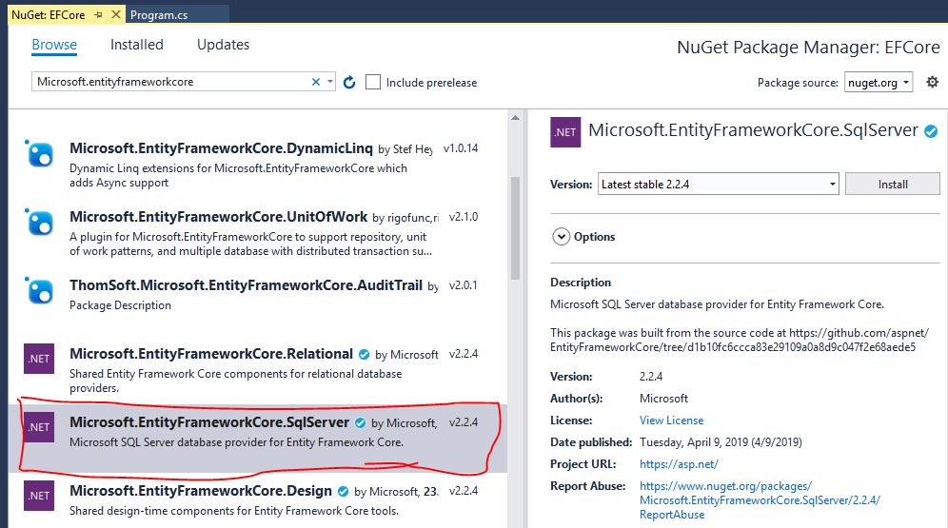
Install EF Core DB Provider
This will open NuGet Package Manager UI. Click on the Browse or the Updates tab and search for Microsoft.entityframeworkcore in the search box at the top left corner, as shown below.

Slide 14
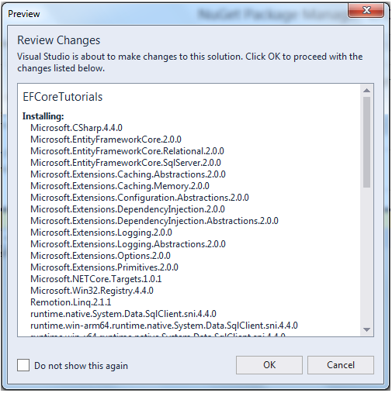
Install EF Core DB Provider
Choose the provider package for the database want to access. In this case select Microsoft.EntityFrameworkCore.SqlServer for MS SQL Server as shown previous slide. (make sure that it has the .NET symbol and the Author is Microsoft). Click Install to start the installation.
The preview popup displays the list of packages it is going to install in application. Review the changes and click OK.
Finally, accept the license terms associated
with the packages that are going to be installed.

Slide 15
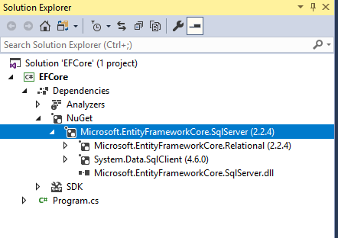
Install EF Core DB Provider
This will install the Microsoft.EntityFrameworkCore.SqlServer package. Verify it in Dependencies -> NuGet, as shown below.
Notice that the provider NuGet package also installed other dependent packages such as Microsoft.EntityFrameworkCore.Relational and System.Data.SqlClient.

Slide 16
Install EF Core Tools
Along with the DB provider package, we also need to install EF tools to execute EF Core commands. These make it easier to perform several EF Core-related tasks in project at design time, such as migrations, scaffolding, etc.
EF Tools are available as NuGet packages. we can install NuGet package for EF tools depending on where we want to execute commands: either using Package Manager Console (PowerShell version of EF Core commands) or using dotnet CLI.

Slide 17
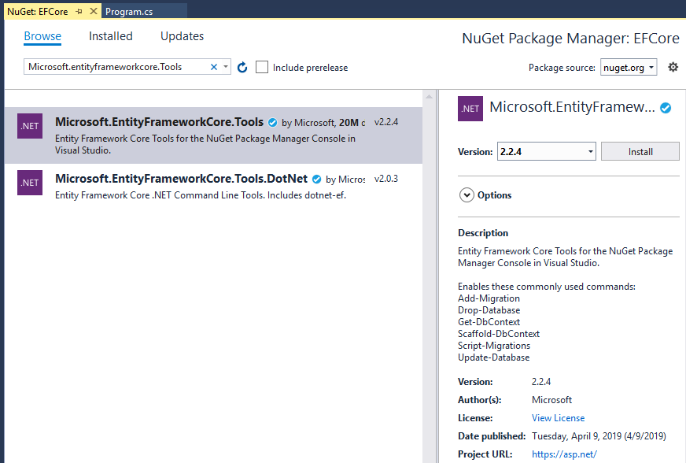
Install EF Core Tools
In order to execute EF Core commands from Package Manager Console, search for the Microsoft.EntityFrameworkCore.Tools package from NuGet UI and install it as shown below.
This will allow to execute EF Core commands for scaffolding, migration etc. directly from Package Manager Console (PMC) within Visual Studio.

Slide 18
Install EF Core Tools
If you want to execute EF Core commands from .NET Core's CLI (Command Line Interface), first install the NuGet package Microsoft.EntityFrameworkCore.Tools.DotNet using NuGet UI.
After installing Microsoft.EntityFrameworkCore.Tools.DotNet package, edit the .csproj file by right clicking on the project in the Solution Explorer and select Edit <projectname>.csproj. Add <DotNetCliToolReference> node as shown below. This is an extra step you need to perform in order to execute EF Core 2.0 commands from dotnet CLI in VS2017.

Slide 19
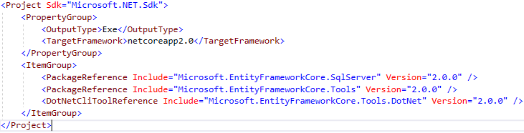
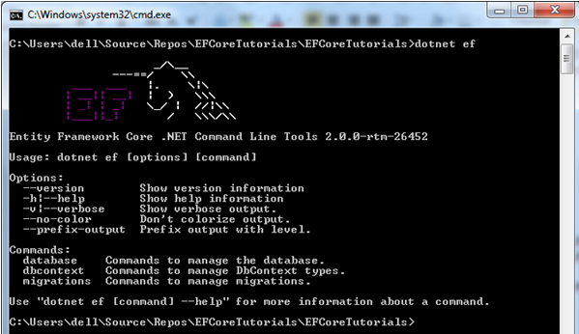
Install EF Core Tools
Now, open the command prompt (or terminal) from the root folder of project and execute EF Core commands from CLI starting with dotnet ef, as shown below.
Thus, you can install required packages for EF Core 2.0
to get started.

Slide 20
Database-First Approach
In Database-First approach the entity and context classes are automatically created by the EF Core from the database. So this means we have first create database for the EF Core.
Notes:
A period sign represents a grid item with no name.

Slide 21
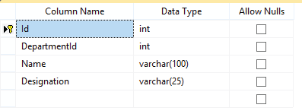
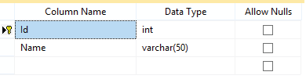
Creating a Database in SQL Server
First Create a simple company’s database in your SQL Server and name it Company. Create 2 tables on it and name them:
Employee
Department
Department
Employee
The id column is both Primary Key and Identity
There is One-to-Many relationship between the Employee & Department table. This is because one department can have multiple employees.

Slide 22
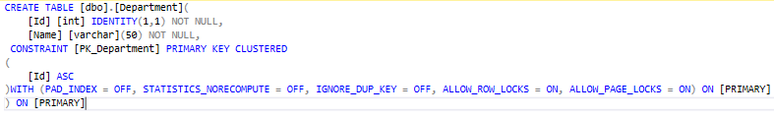
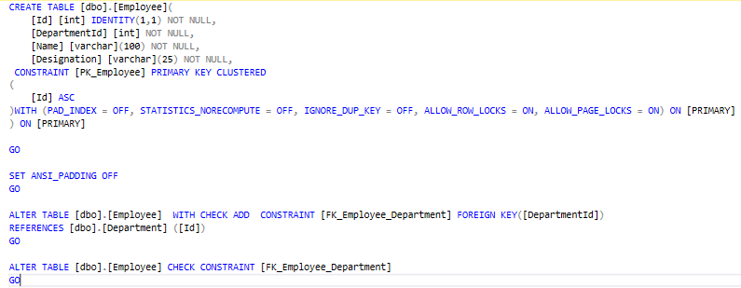
Scripts for the Table
Department
Employee

Slide 23
.NET CLI Scaffolding Command
Now you can run the DotNet CLI Scaffold Command. On the ‘Package Manager Console’ execute the below command:
PM> dotnet ef dbcontext scaffold "Server=Antra;Database=Company;Trusted_Connection=True;" Microsoft.EntityFrameworkCore.SqlServer -o Models
Note database server name is given as Server=Antra
Database=Company; is the name of the database.
Trusted_Connection=True; specifies the Windows authentication. It will use Windows credentials to connect to the SQL Server.
Microsoft.EntityFrameworkCore.SqlServer; is the name of the provider for SQL Server.
-o Models refers to the directory name where all the classes will be generated. Here it is the Models folder.

Slide 24

Context & Entity Class
Once the command is executed we will see the context & entity classes created inside the Models folder.
The 2 entity Classes created are the Employee.cs & Department.cs.

Slide 25
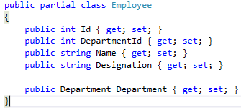
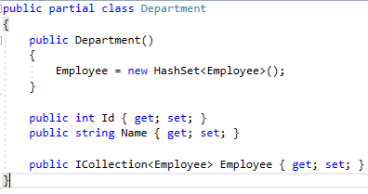
Context & Entity Class
Employee.cs
Department.cs

Slide 26
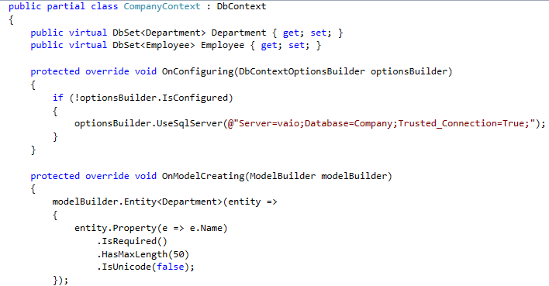
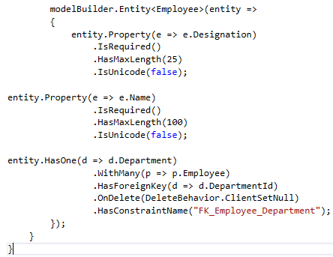
Context & Entity Class

Slide 27
Scaffold-DbContext Command
can skip DotNet CLI Scaffold Command, and use Scaffold-DbContext Command for creating context & entity classes from a database.
This will do the exact same thing.
Run the following command on the Package Manager Console.
PM> Scaffold-DbContext "Server=Antra;Database=Company;Trusted_Connection=True;" Microsoft.EntityFrameworkCore.SqlServer -OutputDir Models

Slide 28
DbContext Class
DbContext class is the brain of Entity Framework Core, using it can do all the communications with the database. It allows performing the following tasks:
Managing database connection.
Configuring entities and the relationships between them.
Reading, creating, updating & deleting data in the database.
Configuring change tracking.
Caching
Transaction management

Slide 29

Using DbContext Class in Application
Take for example – for the company’s database (see the previous slide), can create a new context class and name it CompanyContext.cs. Place this class inside the Models folder
Now derive it from DbContext class that lies under the using Microsoft.EntityFrameworkCore; namespace.
The CompanyContext.cs will look like this:

Slide 30

Using DbContext Class in Application
Next add the DbSet for the 2 entity class. These are the Department and Employee.
The DbSet class represents a collection for a given entity within the model and is the gateway to database operations against an entity.
This will make CompanyContext class look this way:

Slide 31
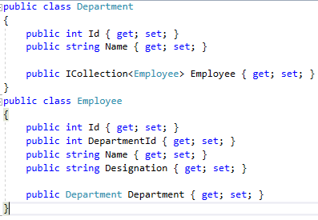
Using DbContext Class in Application
In the company database there are 2 tables – Department & Employee, so the 2 entity classes will be Department.cs and Employee.cs. Place these classes inside the Models folder.
The structure of these files are:

Slide 32
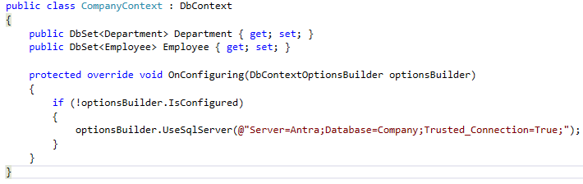
OnConfiguring() Method
The OnConfiguring() method of the DbContext class is overridden inside the context class (i.e. here CompanyContext.cs). It allows to select and configure the data source to be used with a context using DbContextOptionsBuilder which is passed to its parameter.
On adding the OnConfiguring() method to the CompanyContext class, it will look like:

Slide 33
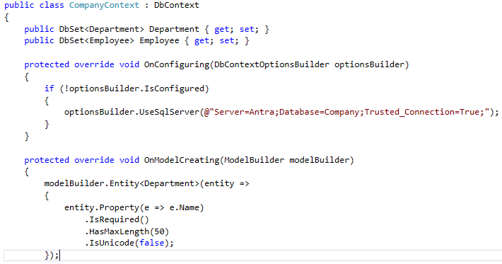
OnModelCreating() Method
The OnModelCreating() method of the DbContext class allows configuring the model using ModelBuilder Fluent API. This method is overridden inside the context class.
After adding it to the CompanyContext class it will look:

Slide 34
OnModelCreating() Method
Inside the OnModelCreating() method we have configured both the Department and the Employee entities.
As you can see, by using the IsRequired() we are making the Name property of the Department class as the required one.
Similarly the HasMaxLength(100) method is used to set the maximum length of Designation property of the employee.

Slide 35
DbContext Method
Method | Description
Add | Adds a new entity with Added state
AddRange | Adds a collection of new entities with Added state
Attach | Attaches a new or existing entity with Unchanged state
AttachRange | Attaches a collection of new or existing entity with Unchanged state
Remove | Attaches an entity with Deleted state
RemoveRange | Attaches a collection of entities with Deleted state
Update | Attaches disconnected entity with Modified state
UpdateRange | Attaches collection of disconnected entity with Modified state
SaveChanges | Execute INSERT, UPDATE or DELETE command to the database for the entities with Added, Modified or Deleted state.

Slide 36
Code-First Approach
In Code-First approach we create the entity classes only. Then with migration commands the EF Core creates the database based on these entity classes.
To understand how the Code-First approach works. First create a new ASP.NET Core project and Install Entity Framework Core on it.
In this project we will be dealing with a Company application that contains information about its employees, departments, etc.

Slide 37
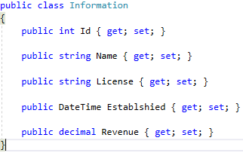
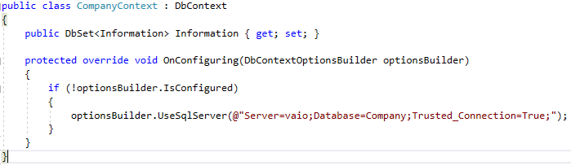
Creating Entity & Context Class
Create a class Information.cs inside the Models folder. It will contain information about the company like company id, name, license, year of establishment and yearly revenue.
Next create a Context class and name it CompanyContext.cs. Place it inside the Models folder.

Slide 38
Creating Migration
With Migration we can create the database based on the Entity & Context classes. Inside the OnConfiguring() method, we have provided the connection string for the database. Here in this case the database name is company.
In Visual Studio, open NuGet Package Manager Console from Tools > NuGet Package Manager >Package Manager Console and enter the following command:
PM> add-migration CompanyDB
Or, we can do the same thing with dotnet CLI by executing the following command:
PM> dotnet ef migrations add CompanyDB

Slide 39
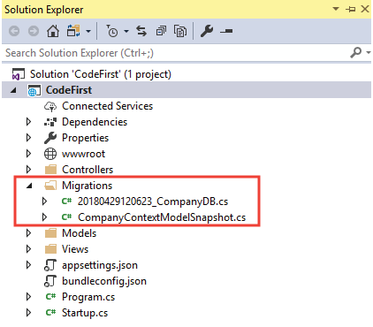
Creating Migration
The command will create Migrations folder on project.
Now create the database by executing the update-database command on the Package Manager Console:
PM> update-database –verbose
Or, we can run the dotnet CLI command to do the same thing:
PM> dotnet ef database update

Slide 40
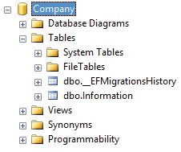
Creating Migration
The command will execute and will create the Company database which we can open and see on SQL Server.

Slide 41
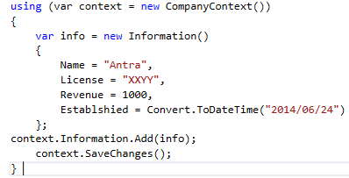
Inserting a Record on the Table using EF Core
Now that database is ready, let insert a record on the Information table.
Add the following code on a Index Action of Controller.
Once the Action is called, the code will execute, and a new record is added to the Information table.

Slide 42
Migration
Using Migrations we can keep the database synchronized with the domain (entity) classes. When developing a project the programmers keep on updating the entity classes. Therefore they need to run migrations to keep the database schema up to date. Migration commands can be execute in NuGet Package Manager Console or in dotnet Command Line Interface (CLI).
To begin understanding the different migration commands of the Entity Framework Core, create a new ASP.NET MVC Core 2.0 project and install Entity Framework Core into it.

Slide 43
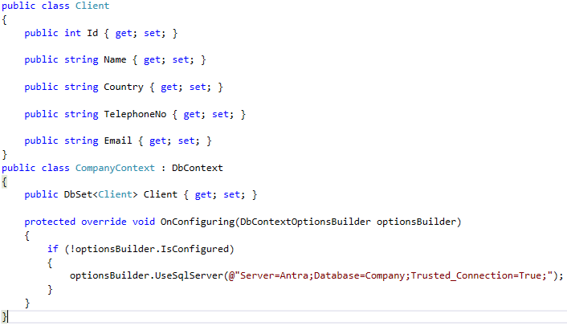
Migration
Add an entity class Client.cs & context class CompanyContext.cs inside the Models folder.
Notes:
The Client.cs is for referencing the client details of the company.

Slide 44
Add Migration Command
The Add Migration command will create Migration files that store data from your entity classes.
On Tools > NuGet Package Manager > Package Manager Console execute any of the following 2 commands to create the migration.
PM> add-migration Migration1
Or DotNet CLI Command:
PM> dotnet ef migrations add Migration1
Notes:
Migration1 is the name of migration.

Slide 45

Adding Migration Command
The migration command will create a folder named Migrations on the application root. This folder contains 3 files.
_.cs: Its the main migration file which includes migration operations named Up() and Down() methods. The Up() method is responsible for creating DB objects while the Down() method removes them.
_.Designer.cs: The migrations metadata file which contains some extra information.
ModelSnapshot.cs: A snapshot of your current model. This is used to determine what changed when creating the next migration.
Now with migration created we can create database.

Slide 46
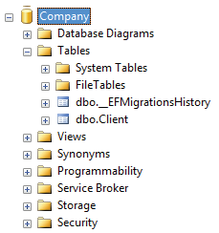
Update Migration Command
The Update Migration command will create the database based on the migration created by the Add migration command.
You can execute either of the 2 update migration command given below:
PM> Update-Database
CLI version:
PM> dotnet ef database update
Now check the SQL Server will find a new database created, which has
Client table on it.
For the first migration, a table called __EFMigrationsHistory, which will
store the name of all migrations, will also be created.

Slide 47
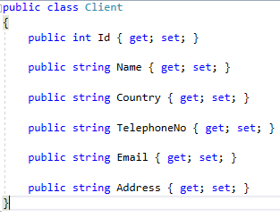
Revert Database to Previous State
On entity class Client.cs we add a new string property for address.
To update the database Client table so that it contains this new Address field. we add a new migration and name it Migration2. Next we run the update command.
PM> dotnet ef migrations add Migration2
PM> dotnet ef database update

Slide 48
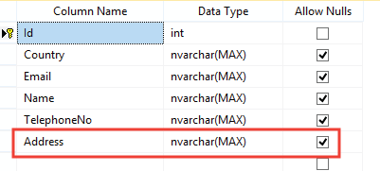
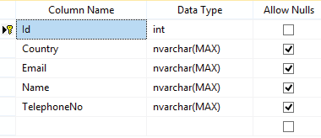
Revert Database to Previous State
If we now check the client table on the database, will see the address field added to it.
Suppose some situation arises and we need to revert the database to the previous state i.e. when the Client table does not have the Address field.
To do this, run the Update command for Migration1 (which is the previous migration).
PM> Update-database Migration1
Or DotNet CLI version:
PM> dotnet ef database update Migration1
Now check the Client table once again, we will see the
Address field removed from it.

Slide 49
Removing Migration Command
With the Remove Migration command we can remove the last migration if it is not applied to the database.
We can execute either of the 2 command given below:
PM> remove-migration
CLI version:
PM> dotnet ef migrations remove

Slide 50
Drop Database
To drop database use any of the following command.
PM> Drop-Database
Or CLI version.
PM> dotnet ef database drop

Slide 51
Generate SQL Scripts
We can also generate SQL Script of the database. To do this, execute either of the following 2 commands.
PM> script-migration
Or CLI version:
PM> dotnet ef migrations script
The script command will generate a script for all the migrations by default. To specify a range of migrations use the -to and -from options.
This script can be executed to form a duplicate database if you have a requirement.

Slide 52
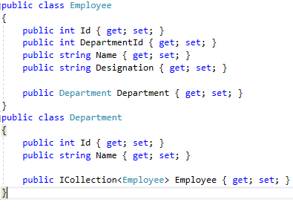
EF Core: Insert Records
We have 2 entity classes, which are Department.cs & Employee.cs, kept inside the Models folder.

Slide 53
EF Core: Insert Records
We also have a Context class named CompanyContext.cs on Models folder.

Slide 54
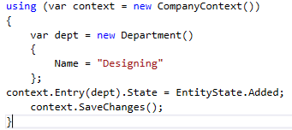

Inserting a Single Record on the Database
We have created a new Designing object of the Department class and set its EntityState to Added.
When the DbContext.SaveChanges() method is called this new record is inserted on the Department table.

Slide 55
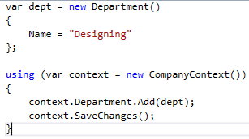
Inserting a Single Record on the Database
There is also a shorter way to insert a record. The below code will do the same thing.
Note that here we don’t have to explicitly set the EntityState to Added, as this is done by EF Core by its own.

Slide 56
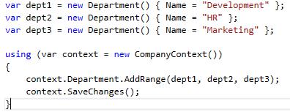
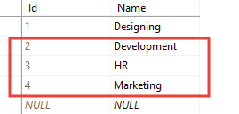
Inserting Multiple Records on the Database
The DbContext.AddRange() method is used to insert multiple entities at the same time.
Here we inserting 3 department records.

Slide 57
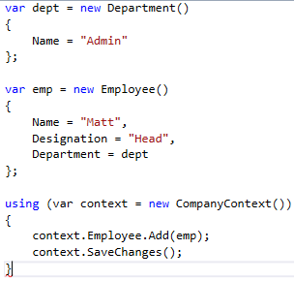


Inserting Related Records in a Database
The Department & Employee tables have many-to-one relationship. Here we will insert one new record on each of these 2 tables (Department & Employee).
Check we have set the Department property of the Employee object to the Department object. In this way EF Core will know the entities are related hence it will insert both of them to their respected tables.
If you check the database, will find both the new records on their respected tables.
Department
Employee

Slide 58
EF Core: Read Records
There are two common ORM patterns used by EF Core to read data.
Eager Loading: In Eager Loading the related data is also loaded at the same time.
Explicit Loading: In Explicit Loading the related data is not loaded at the same time. It is explicitly loaded from the database at a later time.

Slide 59
Eager Loading in EF Core
In Eager Loading the related data is also loaded from the database at the same time, as part of the initial query.
In Eager Loading Include() method is used to read the related entity.
The Employee entity has a Department related entity so the Include() method can be used to do the eager loading of department record like shown below:

Slide 60
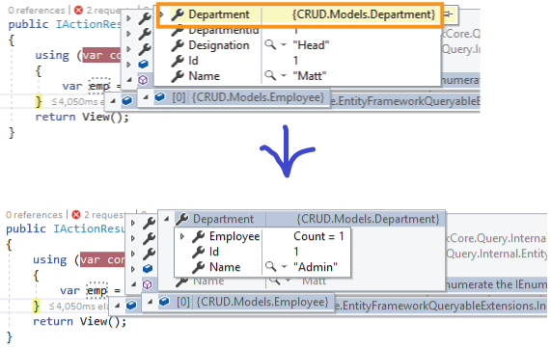

Eager Loading in EF Core
If we put the breakpoint on Visual Studio and check the value of emp variable, will find the value of Departmentproperty filled to.
The Include() method will execute a single SQL query on the database to fetch the data.
This SQL query is given below:

Slide 61
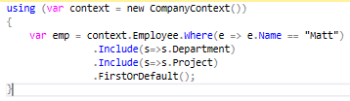
Multiple Include() Method
We can also use multiple Include() methods to load multiple related entities.
For example, if the Employee entity also has another related entity Project. Then the following code loads the Department & Project entities of the Employee.

Slide 62
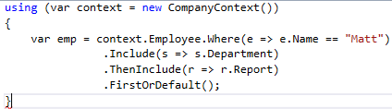
ThenInculde() Method
Entity Framework core has another method named ThenInclude() that is used to load multiple levels of related entities.
For example suppose we have a related entity named Report of the Department entity.
Then see the below code:
.Include(s=>s.Department) will load the Department related entity of the Employee entity.
Next, .ThenInclude(r=>r.Report) will load the Report entity of the Department entity.

Slide 63

Explicit Loading in EF Core
In Explicit Loading the related data is explicitly loaded from the database at a later time. Here the Load()method is used to load related entity explicitly.
Consider the below code:
The context.Entry(emp).Reference(s => s.Department).Load() loads the Department entity of the Employee. The Reference property gets the reference of related entity and the Load() method loads it explicitly.

Slide 64
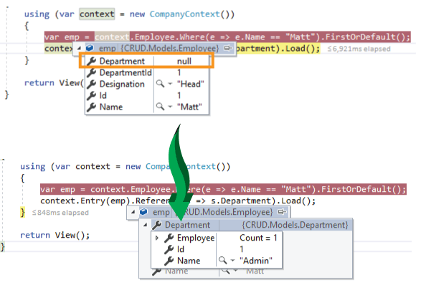
Explicit Loading in EF Core
If we want to filter the related entity before loading then use the Query() method.
The below code will only load the Department having name as ‘Admin’.

Slide 65
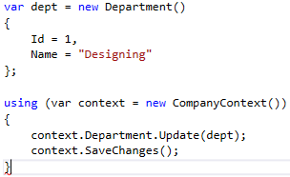
EF Core: Update Record
The Entity Framework Core executes UPDATE statement in the database for the entities whose EntityState is Modified. The DbContext tracks of all entities and those that are modified it sets there EntityState as modified.
We will use the DbContext.Update() method for updating entities.
Consider the below code:
The above code updates the Department name, of department with Id ‘1’, as Designing.
The reason why EF Core does the update here is because the entity has a valid property key value (which is ‘1’ in this case). So it sets its EntityState to Modified.

Slide 66
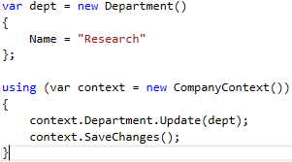

EF Core: Update Records
If there is no valid property key value then EF core will set the EntityState to Added. The below code does not have Id property for Department entity, So on doing the update the EF core Inserts a new Department record on the database.
Here the .Update() method will insert a new Research record on the Department table.

Slide 67
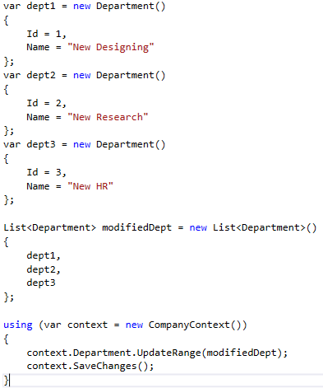
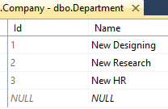
Update Multiple Records
Use DbContext.UpdateRange() method to update multiple entities at the same time.
Consider the below code where updating 3 Department records at the same time.

Slide 68
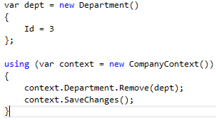
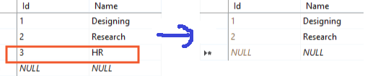
EF Core: Delete Records
EF Core API builds and executes the DELETE statement in the database for the entities whose EntityState is set as ‘Deleted’. The method DbContext.Remove() is used for deleting entity.
Consider the following code which deletes Department with Id ‘3’.
Once the Remove() method is called for the department entity, the EF marks the 3rd id as Deleted. Finally when the SaveChanges() method is called the 3rd department record is deleted from the database.

Slide 69
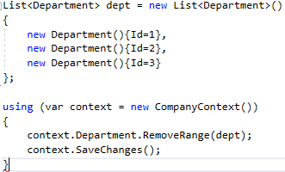
Delete Multiple Records
Use DbContext.RemoveRange() to delete multiple entities in one go. The below codes remove 3 Department records of Ids – 1, 2 & 3 in one go.

Slide 70
Delete Related Records
If an entity has relationship with other entities such as one-to-one or one-to-many then deleing related data when the root entity is deleted depends on how the relationship is configured.
By using Fluent API you can define referential constraint options. There are 4 options:
Cascade : Related entities are deleted.
ClientSetNull: Foreign key properties in the dependent entities will be set to null.
Restrict: Prevents Cascade delete.
SetNull: The values of foreign key properties in the dependent entities will be set to null.

Slide 71
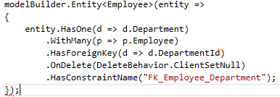
Delete Related Records
On the Context file of your application you will see the referential constrains applied with the .OnDelete()method. See the below code:

Slide 72
Conventions
Conventions are default rules using which Entity Framework builds a model based on domain (entity) classes. EF Core API creates a database schema based on domain and context classes, without any additional configurations because domain classes were following the conventions.

Slide 73
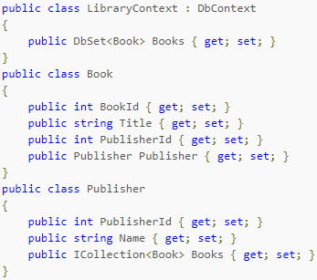
Table
EF Core will create database tables for all DbSet<TEntity> properties in a context class with the same name as the property. It will also create tables for entities which are not included as DbSet properties but are reachable through reference properties in other DbSet entities.
In the following example, EF Core will map the Book entity (which has a DbSet property in the DbContext class) to a table named Books and the Publisher entity (which has no DbSet, but takes part in a fully defined relationship with Book) to a table named Publisher:

Slide 74


Primary Key
If a property is named ID or <entity name>ID (not case-sensitive), it will be configured as the primary key. Entity Framework Core will prefer ID over <entity name>ID in the event that a class contains both. The following examples illustrate two versions of a Book entity where the int property follows the convention:
EF Core will specify that the primary key column values are generated automatically by the database.

Slide 75
Foreign Key
The convention for a foreign key is that it must have the same data type as the principal entity's primary key property and the name must follow one of these patterns:
<navigation property name><principal primary key property name>Id
<principal class name><primary key property name>Id
<principal primary key property name>Id

Slide 76
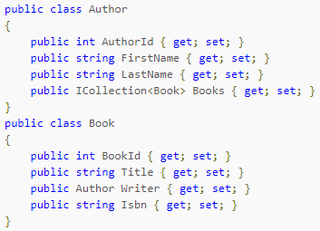
Example
In the example model below, no foreign key property has been defined in the dependent Book entity.
In order of precedence, the following property
names are accepted:
WriterAuthorId
AuthorAuthorId
AuthorId
As with primary keys, foreign key property name matching is not case sensitive. EF Core infers the multiplicity of a relationship from the nullability of the foreign key. If the property is not nullable, the relationship is registered as required; otherwise it is registered as optional.

Slide 77
Conventions
Schema
EF Core will create all the database objects in the dbo schema by default.
Column
EF Core will create columns for all the scalar properties of an entity class with the same name as the property, by default. It uses the reference and collection properties in building relationships among corresponding tables in the database.
Nullable Column
EF Core creates null columns for all reference data type and nullable primitive type properties e.g. string, Nullable<int>, decimal?.
NotNull Column
EF Core creates NotNull columns in the database for all primary key properties, and primitive type properties e.g. int, float, decimal, DateTime etc..
Indexes
EF Core creates a clustered index on Primary key columns and a non-clustered index on Foreign Key columns, by default.

Slide 78
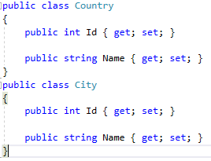
One-to-Many Realtionship
Suppose you want to create 2 database tables – Country & City. You want to have One-to-Many relationship between them so that many cities are associated with one country.
These are the 2 Classes – Country & City, with the following properties.

Slide 79
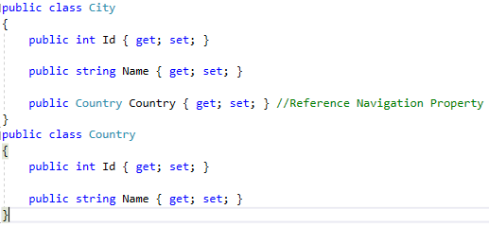
Convention 1: Create a Reference Navigation Property
On the ‘City’ class create a reference navigation property pointing to the ‘Country’ class as shown below:

Slide 80
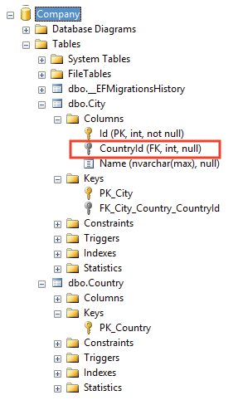
Convention 1: Create a Reference Navigation Property
On applying the Migration it will produce a one-to-many relationship (foreign key) between the City and Country tables in the database, where City table includes a nullable foreign key CountryId, as shown below.

Slide 81

Convention 2: Create a Collection Navigation
Another way to create one-to-many relationship is by adding collection navigation property ICollection in the Country class as shown below.
Notes:
This will do the same work as the convention 1.

Slide 82

Convention 3: Create Reference & Collection Navigation Properties
We can also create both Reference & Collection navigation properties on the entities to create foreign key relationship (One-to-Many).

Slide 83

Convention 4: Use Convention 3 + Foreign Key Property
Here we use the Convention 3 and also adds a foreign key property CountryId of type int on the City entity.

Slide 84


One-to-One Relationship
Creating One-to-One relationship between entity classes is very simple in EF Core. All we have to do is add Reference Navigation properties on both the entities.
In the below code, created One-to-One Relationship between the ‘Country’ & ‘City’ entity classes.

Slide 85
Configurations
If you want to override the conventions then apply the configurations and customize the EF model to database mappings.
There are 2 configuration methods in EF Core:
Data Annotation Attributes
Fluent API

Slide 86
Data Annotations Attributes
These are the .NET Attributes that can be applied to the domain classes and their properties.
The Data Annotation attributes are included in separate namespace System.ComponentModel.DataAnnotations.

Slide 87


Example
In the below code we have applied Data Annotation Attributes to the domain classes and their properties.

Slide 88


Example
Once we apply Migration, will get 2 database tables created with different names (due to [Table(“Name”)] attribute on the classes). These tables are:
TBL_City
TBL_Country
The TBL_City has:
KeyId column as primary key.
CityName column with data type varchar(25).
FKid as foreign key column.
The TBL_Country has:
KeyId column as primary key.
Name column with data type nvarchar(20).

Slide 89
Understanding how Data Annotations Attributes Works
Attribute | Description
Table | Applied on entity class to give a name to database table.
Column | Applied on a property to give column name, order and data type.
Key | Sets the property as primary key for the table.
ForeignKey | Applied to a property to mark it as foreign key.
NotMapped | Can be applied to entity class or property for not generating a corresponding table or column in the database.
MaxLength | Sets the max length for the table column.
Required | Can be applied on properties to make the corresponding column on the table as not null.

Slide 90
EF Core: Fluent API
We can override the default conventions of Entity Framework Core using Fluent API. By using it, we can configure many different things, as it provides more configuration options than Data Annotation Attributes. Also, Fluent API configurations have higher precedence than data annotation attributes.
Entity Framework Core Fluent API offers:
Model Configuration: Configures an EF model to database mappings.
Entity Configuration: Configures PrimaryKey, AlternateKey, Index, table name, one-to-one, one-to-many, many-to-many relationships etc.
Property Configuration: Configures property to column mapping e.g. column name, default value, nullability, Foreignkey, data type, etc.

Slide 91


How to use Fluent API
Suppose we have a domain class named Country:
In order to use Fluent API, override the OnModelCreating() method of the Context class.

Slide 92

How to use Fluent API
In the above code the Country entity is configured in the following manner:
We have set its PId property as primary key using the HasKey() function.
We have configured its Name property to be set as CountryName on the database table, and it should be a not null column with default value as USA.
The AddedOn property is configured to be of date data type with default sql value given by getdate()method.
The Population will not be mapped to the database table i.e. its column will not be created. The Ignore() method has done this configuration here.
On doing the migration the Country table will be created on the database:

Slide 93
Common Fluent API Methods
Configurations | Fluent API Methods | Usage
Model Configurations | HasDbFunction() | Configures a database function
 | HasDefaultSchema() | Specifies the database schema
 | HasSequence()td> | Configures the database sequence
Entity Configuration | HasIndex() | Configures a property as Index
 | ToTable() | Configures the name of the database table that the entity corresponds to.
 | HasKey() | Configures a property as Primary Key
 | HasOne() | Configures the One part of the relationship, for one-to-one or one-to-many relationships.
 | HasMany() | Configures the Many part of the relationship, for one-to-Many or many-to-many relationships.
 | HasForeignKey() | Configures the property as the foreign key
 | Ignore() | Specifies the property should not be mapped to a database table

Slide 94
Common Fluent API Methods
Property Configuration | HasColumnName() | Specifies the column name in the database for the property
 | HasColumnType() | Specifies the data type of the column in the database for the property
 | HasDefaultValue() | Specifies the default value of the column in the database for the property
 | HasDefaultValueSql() | Specifies the default value expression of the column in the database for the property. Eg getdate()
 | HasMaxLength() | Specifies the maximum length of the column in the database for the property
 | IsRequired() | Specifies the database column should be not null.
 | IsUnicode() | Specifies that the column should contain Unicode characters.
 | ValueGeneratedOnAdd() | Configures that the property has a generated value when saving a new entity.

Slide 95

Fluent API: One-to-Many Relationship
Consider the following Country and City entities.
Notes:
Conventions in EF are sufficient to create One-to-Many relationships and basically you don’t need Fluent API to create this One-to-Many relationship. Only for code maintenance and understanding you can use Fluent API for creating One-to-Many relationships.

Slide 96

Fluent API: One-to-Many Relationship
We will Configure the one-to-many relationship for these 2 entities using Fluent API by overriding the OnModelCreating method in the context class, as shown below.

Slide 97

Fluent API: One-to-Many Relationship
On performing migration we will get Country and City tables created having foreign key FKCountry on the city table.

Slide 98

Understanding how One-to-Many Relationship is configured
Start by configuring one entity (either Country or City class). Start with City class (modelBuilder.Entity).
Next .HasOne(e => e.Country) specifies that the entity contains the reference property of other type (i.e. Country) for one-to-one relationship.
Next move to the other end of the relationship with .WithMany(e => e.City). It specifies that the ‘Country’ entity includes collection navigation property of City type.
The .HasForeignKey(e => e.FKCountry) specifies that the property FKCountry is the foreign key for the City table.
We can also configure the relationship starting with Country entity instead of the City entity. See the below code:

Slide 99

Cascade Delete in Fluent API for Foreign Keys
EF Core behaves differently when the parent entity of the foreign key is deleted. We can configure this using Fluent API.
WE can instruct EF Core to – delete the child row if the related parent row is deleted, or set foreign key to null, or prevent delete.
This is done from .OnDelete() method.
On the below code we have set ‘DeleteBehaviour’ as Cascade which means the dependent entity will be deleted when its parent entity is deleted.

Slide 100
Cascade Delete in Fluent API for Foreign Keys
The DeleteBehaviour has 4 values:
Cascade: Dependent entities will be deleted if its principal entity is deleted.
ClientSetNull: The values of foreign key properties in the dependent entities will be set to null when its parent entity is deleted.
Restrict: Prevents Cascade delete.
SetNull: The values of foreign key properties in the dependent entities will be set to null when its parent entity is deleted.

Slide 101


Fluent API: Many-to-Many Relationship
Consider the 2 entity classes – ‘Student’ & ‘Teacher’.
To create a Many-to-Many relationship using Fluent API you have to create a Joining Entity. I name this joining entity as – ‘Teacher Student’.
Many-to-Many relationship between the ‘Student’ & ‘Teacher’ entities will mean – ‘one student can have many teaches’ and at the same time ‘one teacher can have many students’.
Notes:
Note that there are no default conventions in Entity Framework Core to automatically configure a many-to-many relationship. Therefore we must configure it using Fluent API.

Slide 102

Fluent API: Many-to-Many Relationship
This joining entity will contain the foreign keys (reference navigation property) for both the other entities. These foreign keys will form the composite primary key for this joining entity.
The Teacher Student entity is given below.

Slide 103


Step to Configuring Many-to-Many Relationships
Add foreign key property to other entities, in the joining entity.
Add collection navigation property on the other entities towards the joining entity.

Slide 104

Step to Configuring Many-to-Many Relationships
Configure both the foreign keys in the joining entity as a composite key using Fluent API. Do this in the OnModelCreating() method.
Create one-to-many relationship using Fluent API between the joining entity and other entities inside the OnModelCreating() method.

Slide 105

Step to Configuring Many-to-Many Relationships
On migration we will get the Many-to-Many relationship created as shown in the below image:

Slide 106

Step to Configuring Many-to-Many Relationships
The full code of context class is:

Slide 107
Execute SQL Queries
Entity Framework Core has a powerful method known as .FromSql() which is used to Execute Raw SQL Queries including Parameterized Queries. This method returns an entity object.

Slide 108

Example 1: Execute Raw SQL Query with .FromSql() method
Consider a Student entity:
To get all students that are in ‘Standard 10’ we can execute an SQL query using .FromSql() method like this:
Here raw query – Select * from Student where Name = ‘Tony’ will be executed on the database and will give list of all students that are in ‘standard 10’.

Slide 109
Example 2: Execute Parameterized Queries with .FromSql method
The following code shows how to execute Parameterized query with .FromSql method. It will give all the students that have ‘name as Tony’.

Slide 110
Using LINQ Operators with .FromSql method
We can also use LINQ Operators after the result from .FromSql() method.
The below code contains the .OrderBy() LINQ Operator that gives the result in ascending order of Student’s name.

Slide 111

Execute Stored Procedure
SQL Stored Procedures can also be easily executed using the .FromSQL() & .ExecuteCommand() methods in Entity Framework Core. The result from Stored Procedure is returned back to the code.
Below is the SQL Stored Procedure that returns all Students that have a particular name and standard. The name & standard values are provided through the ‘name’ & ‘standard’ input parameters of the Stored Procedure.

Slide 112

Executing the Stored Procedure using .FromSql() method
The above stored procedure has 2 input parameters which have to be provided when using the .FromSql()method. Therefore we have to use SqlParameter array to sets these parameters.
The below code executes the stored procedure.
Notes:
The SqlParameter class resides inside System.Data.SqlClient; namespace.

Slide 113

Stored Procedures that return Multiple Record Sets
We have to remember that the .FromSql() method gets only one record set from a stored procedure. If the Stored procedure returns multiple record sets then use the ExecuteReader() method.
The below procedure returns 2 record sets – one from ‘Student’ table and other from ‘StudentAddress’ table.

Slide 114


Stored Procedures that return Multiple Record Sets
This is how to use ExecuteReader() method to get the values from both the record sets.
Notes:
Note: .NextResult() moves to the next record set.

Slide 115
Execute Stored Procedure using ExecuteSqlCommand()
The ExecuteSqlCommand() is another method to execute Stored Procedures and Raw SQL in Entity Framework Core. But unlike FromSql() method, it returns the number of affected rows.

Slide 116


Working with output parameters of Stored Procedure using ExecuteSqlCommand()
Output parameters are provided with out keyword in .FromSql() method.
Here we have updated the Stored Procedure with one output parameter – ‘@TotalStudents’ which returns the total students in the table.
To execute this Stored Procedure add a new SqlParameter with direction output:

Slide 117

Working with output parameters of Stored Procedure using ExecuteSqlCommand()
Once the stored procedure is executed we can get the value returned by the output parameter like this:
The Complete Code:
Notes:
Note: Parameter starts with index 0. There are total 3 parameters and the last one is the output parameter here.

Slide 118
Thank You

